Slide 1
Causes and Mechanisms of Depression
An Introduction
Considering Animal Models

Slide 2
Major Depressive Disorder Clinical Depression
Clinical Symptoms vary
reduced mood, pleasure and concentration
disturbed sleep, increased fatigue, irritability
loss of self-worth, suicide risk
May represent unique disorders
Struggle to Cope
with daily personal and social lives
Often has a Social component
Comorbid with other health conditions

Slide 3
Heritability of Depression
Genetic Factors contribute up to 50%
Complex array of stress-related genes
Carrying a gene does not confer expression
Does not determine symptoms
Epigenetics
Heritable biochemical signals
Bind to specific DNA sequences or linked proteins
Do not alter the DNA sequence
Alter the likelihood of Gene Expression

Slide 4
Gene by Environment Interactions
Epigenetic Mechanisms

Slide 5
Environmental Epigenetics
The Genome of an Individual is invariable
But…Environmental Factors influence Gene Action
How?
Epigenetic Factors change exposure of Genes
DNA methylation
Histone methylation, acetylation, phosphorylation (more)
Increase or decrease Gene Expression
Specific genes only
Often related to stress

Slide 6
Environmental Epigenetics and Depression
Chronic Stress → DNA methylation
Promoter: corticotropin-releasing factor (CRF) gene
Result: increased levels of this stress hormone
Early Adversity → Histone + DNA methylation
glucocorticoid receptor (GR) gene in hippocampus
Result: reduced negative feedback during stress
Increased stress hormone (cortisol)
Increased vulnerability to stress
Increased susceptibility to Depression

Slide 7
Major Theories of Depression
Not mutually exclusive

Slide 8
Depression Theories (from Treatments and Research)
Monoamine (serotonin = 5-HT) deficiency
First and Most widely accepted theory
Based on 5-HT reuptake inhibitor efficacy (SRI)
Most modern antidepressant drugs also include
norepinephrine (NE) reuptake inhibition (NRI)
And/or dopamine (DA) reuptake inhibition (DRI)
< 50% are satisfactorily treated
No clear mechanism
6-8 wk delay precludes deficiency as the cause
5-HT_{T} linked polymorphic region gene is related

Slide 9
Depression Theories (from Treatments and Research)
Neurotrophic (Brain-Derived Neurotrophic Factor)
↑BDNF in Hippocampus →↓ Depressive Behaviors
↓BDNF linked to ↑Depressive symptoms
↑BDNF associated with clinical recovery
Stimulates neuroplasticity and neurogenesis
Associated with reduced depression
BDNF → ↓ 5-HT reuptake (similar to SRIs)
BDNF → 5-HT_{T} regulation
↑BDNF in Nucleus Accumbens → ↑Depressive Behaviors
Val66Met BDNF mutant →↑ vulnerability to Depression

Slide 10
Depression Theories (from Treatments and Research)
Neuroinflammation
Activated by social stress
↑ cytokines: IL₁, IL₆, TNF_{α}
Similar to Major Depression
→ ↓ BDNF and other neurotrophins
Depression induces ↑ inflammatory responses
to stress
Gut-Brain Connection
Probiotic diversity reduces depression

Slide 11
Depression Theories (from Treatments and Research)
Chronic Social Stress
Clinically linked to depression in humans
Links Childhood Trauma to Depression
Dramatically effects 5-HT, DA, and NE concentrations
Promotes epigenetic changes
Enhances expression of 5-HT_{T}-LPR (short version)
For carriers of the gene mutant
↓ 5-HT_{T} expression → ↑ synaptic 5-HT
↑ Amygdala response to fear and stress
Greater susceptibility to Depression

Slide 12
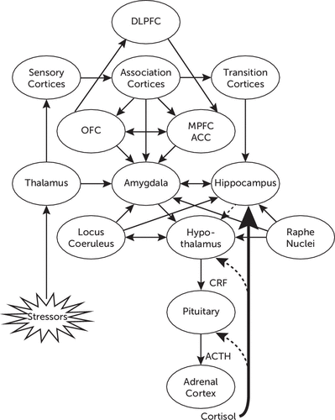
Chronic Social stress
Links many of the other theories

Slide 13
Current Animal Models of Depression
Pre-clinical models

Slide 14
Pre-Clinical Models should have Construct, Face, & Predictive Validity
Construct Validity
Experimental Conditions replicate
Cause of the disease
Difficult when causes are not completely known
Face Validity
Model Symptoms replicate
Clinical Indications of the disease
Predictive Validity
Animal response to therapy predicts clinical success

Slide 15
Pre-Clinical Models should have Construct, Face, & Predictive Validity
Factor Administration
e.g. Retinoids (Stress Axis)
Cytokines (Immune Function)
Genetic knockouts
Surgery
Olfactory Bulbectomy

Slide 16
Pre-Clinical Models should have Construct, Face, & Predictive Validity
Learned Helplessness
Inescapable foot shock; short-term only
Chronic Mild Stress
6-7 stressors changed daily and randomly
H₂O deprivation, wet bedding, tilting cage, isolation, crowding, changed lighting rhythm, cage vibration, food deprivation, forced swim, intermittent white noise…
no social component
Models with a social component
Are the most translatable to Clinical Success
Chronic Social Isolation

Slide 17
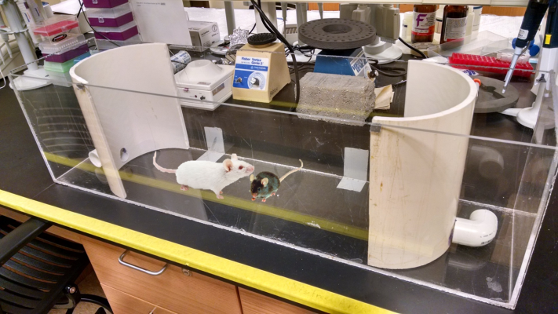
Social Models have greater Construct, Face, & Predictive Validity
Chronic Social Stress
10 days of defeat
Paired with a Novel for 10 min each day
Cohabits with Aggressor, separated by wire mesh
Followed by tests of despair and anhedonia
Stress-Alternatives Model (Summers Lab)
Depression and Anxiety
4 days of novel social aggression
Escape is possible for the test animal only

Slide 18
Tests of Depressive Behavior
Where the rubber meets the road for Validity

Slide 19
Tests of Behavioral Despair
Forced Swim Test
Tail SuspensionTest
Measured by how long it takes the test animal to stop moving
More movement: supposed to equate to less despair

Slide 20
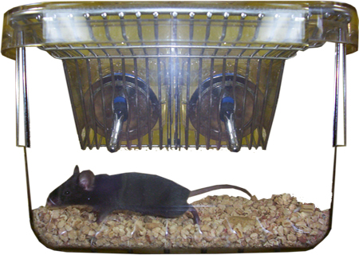
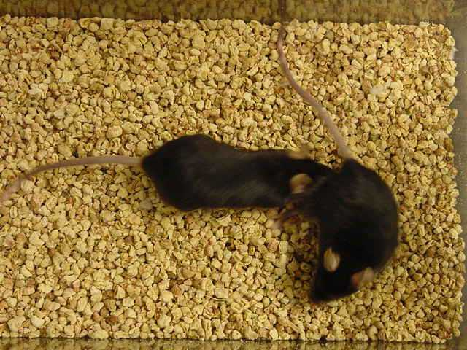
Tests of Anhedonia
Sucrose Preference
Sexual Interest
Measured by preference for sugar water over plain H₂O
or time to show interest in sexual activity with a receptive partner
More interest: supposed to equate to greater interest in pleasure

Slide 21
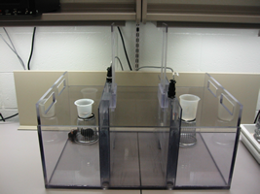
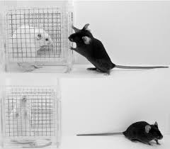
Tests of Social Avoidance
Measured by ratio of time in proximity to social versus non-social conditions
More Social Contact: Less Depressive Behavior

Slide 22
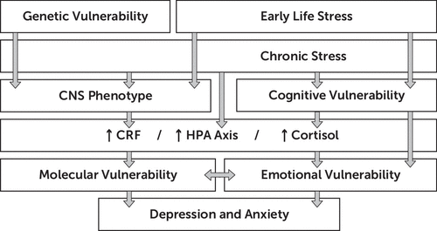
Research in Depression must consider These Critical Elements
Epigenetic &

